Slide 1
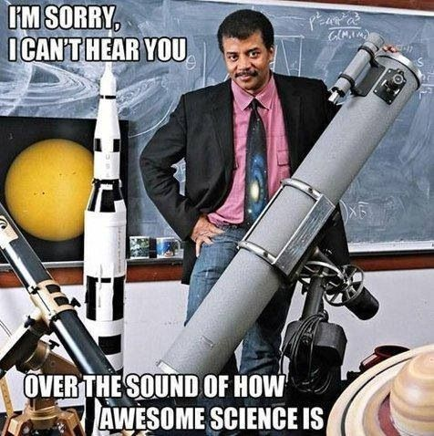
Science Olympiad

Slide 2
2016 Olympiad Events
Anatomy and Physiology
Bottle Rocket
Crime Busters
Disease Detectives
Dynamic Planet
Ecology
Experimental Design
Fast Facts
Food Science
Hovercraft
Invasive Species
Meteorology
Microbe Mission
Mission Possible
Optics
Reach for the Stars
Road Scholar
Rocks and Minerals
Scrambler
Towers
Wind Power
Wright Stuff
Write it, Do it

Slide 3
Helpful Hints About Event Selection
All events can handle a team of two (unless specified otherwise). You will have a part-time/full-time coach for your event.
Teams that have participated in a particular event in previous years…have preference in that even.
Hands-on events are known for being more competitive then paper test events. So if your knowledgeable on paper…your more likely to win hardware (an award).

Slide 4
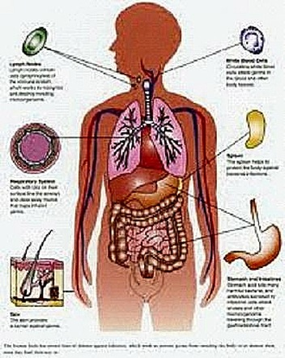
Anatomy and Physiology
Description: Students demonstrate a basic understanding of human Cardiovascular, Integumentary, and Immune systems.
Team: 2
Type: Paper Test
Topics: Medicine, Anatomy

Slide 5
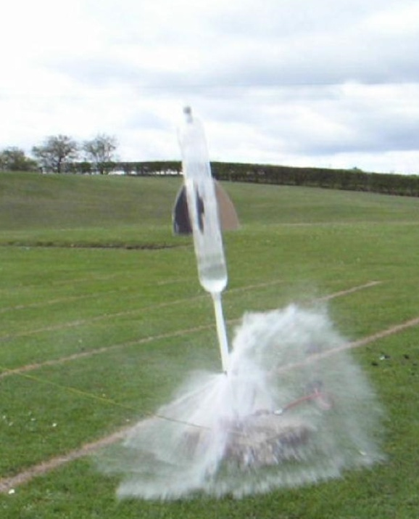
Bottle Rocket
Description: Creation of two rockets that need to stay aloft for a maximum period of time.
Team: 2
Type: Hands-on
Topics: Chemistry, Physics, Mechanics

Slide 6
Crime Busters
Description: Solve a crime given evidence and a list of suspects
Team: 2
Type: Hands-on/Paper
Topics: Chemistry, Lab Safety

Slide 7
Disease Detectives
Description: Students will investigate the study of disease, injury, health, and disability with a focus on population growth
Team: 2
Type: Paper Test
Topics: Medicine, Ecology

Slide 8
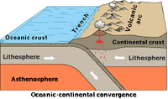
Dynamic Planet
Description: Students will complete tasks related to oceanography and marine sciences.
Team: 2
Type: Some Hands-on/Paper Test
Topics: Geology, Oceanography

Slide 9
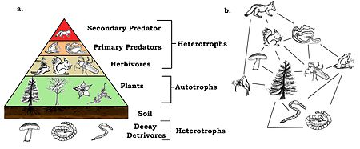
New: Ecology (Critter Interactions)
Description: Students answer questions related to ecology and adaptations in North American Enviroments
Team: 2
Type: Paper Test
Topics: Biology, Ecology (7th grade stuff)

Slide 10
Experimental Design
Description: Students will design, conduct, and report findings on an experiment conducted on site
Team: 2
Type: Hands-on /Paper Test
Topics: Chemistry, Lab Safety

Slide 11
New: Fast Facts
Description: Students will match words with science categories in a puzzle style format.
Team: 2
Type: Paper Test
Topics: General Science Terms

Slide 12
Food Science (New)
Description: Students will study the chemsitry behind food and determine the energy content for certain foods.
Team: 2
Type: Hands-on/Paper Test
Topics: Chemistry,

Slide 13
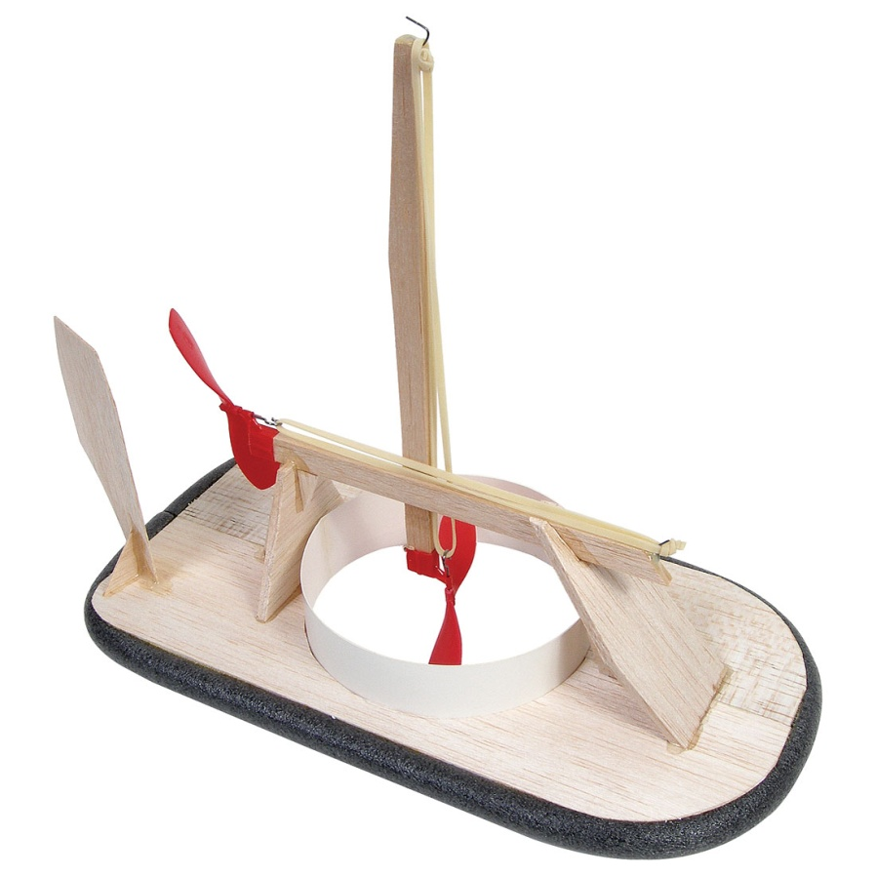
New: Hovercraft
Description: Students must create a working hovercraft using 2 battery powered motors. Students will also need to answer basic physics questions as part of the event.
Team: 2
Type: Hands-on/Paper Test
Topics: Mechanics, Physics

Slide 14
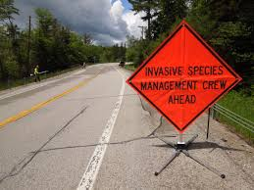
Invasive Species
Description: Students will be tested on invasive species in local and national ecosystems.
Team: 2
Type: Paper Test
Topics: Ecology, Biology

Slide 15
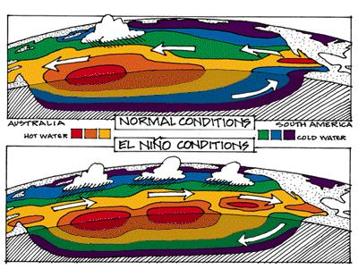
Meteorology
Description: Students will investigate human impact to the atmosphere, weather, and climate.
Team: 2
Type: Paper Test
Topics: Meteorology (no way! ☺)

Slide 16
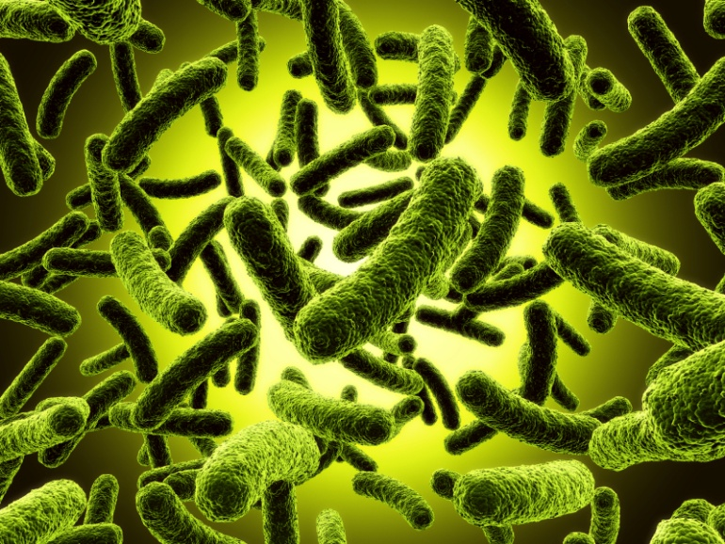
New: Microbe Mission
Description: Students will answer questions, solve problems, and analyze date related to microbes.
Team: 2
Type: Hands-on /Paper Test
Topics: Microscopy, Biology

Slide 17
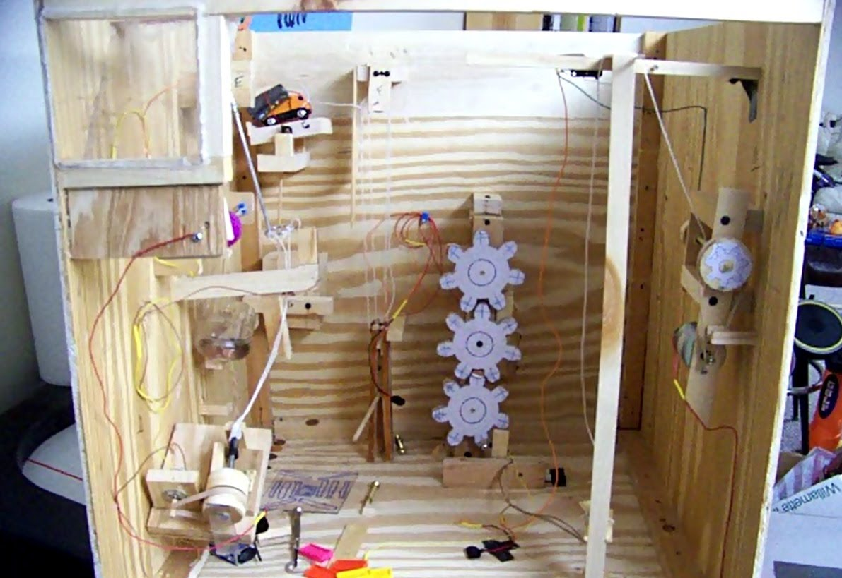
Mission Possible
Description: Students create a complex machine to complete a task within an ideal time
Team: 2
Type: Hands-on
Topics: Mechanics, Physics

Slide 18
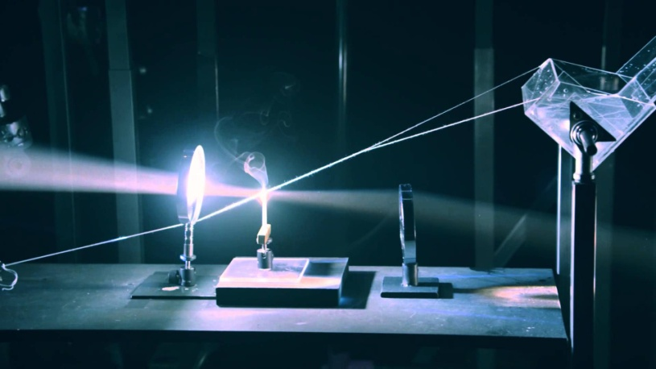
New: Optics
Description: Students will participate in an activity to position mirrors to direct a laser to the target. Students will also be tested on optics concepts.
Team: 2
Type: Hands-on /Paper Test
Topics: Physics, Geometry

Slide 19
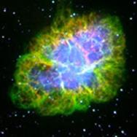
Reach for the Stars
Description: Students are asked to identify stellar objects including stars and galaxies based on properties like light and shape.
Team: 2
Type: Paper
Topics: Space Science

Slide 20
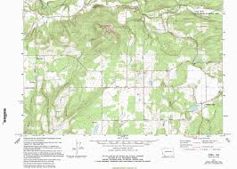
Road Scholar
Description: Students will be asked to identify features on maps and answer specific questions about items including direction, distance, and slope.
Team: 2
Type: Some Hands-on/Paper Test
Topics: Geography, Geology

Slide 21
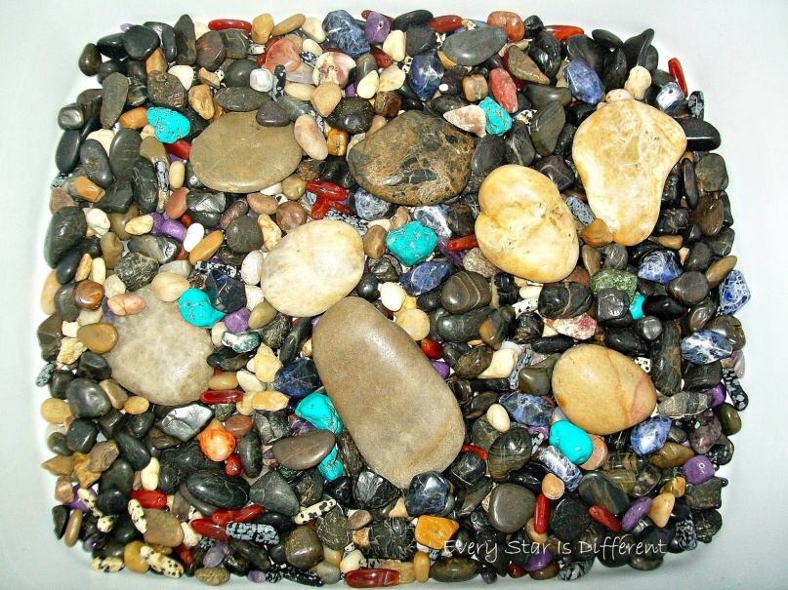
New: Rocks and Minerals
Description: Students will demonstrate their knowledge of rocks and minerals.
Team: 2
Type: Hands-on/Paper Test
Topics: Chemistry, Lab Safety

Slide 22
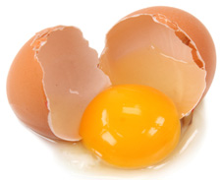
Scrambler
Description: Students must create a machine that uses falling mass to safety transport an egg to a location.
Team: 2
Type: Lab
Topics: Biology, Physics

Slide 23
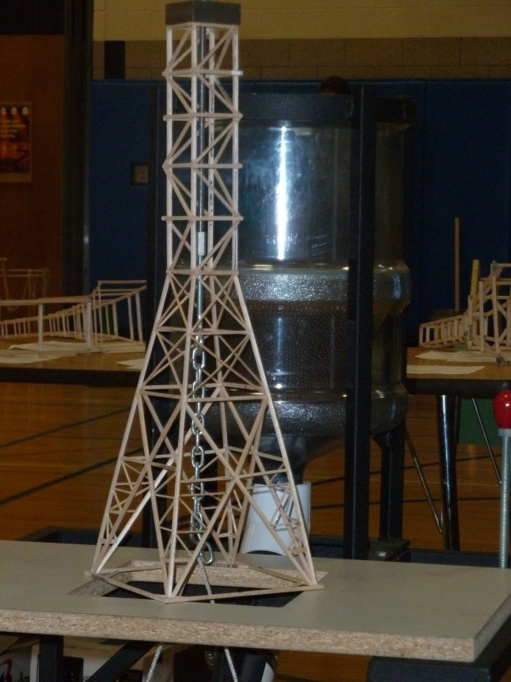
New: Towers
Description: Students will design and construct a tower that follows the guidelines and also has the most efficient build.
Team: 2
Type: Hands-on
Topics: Physics, Construction

Slide 24
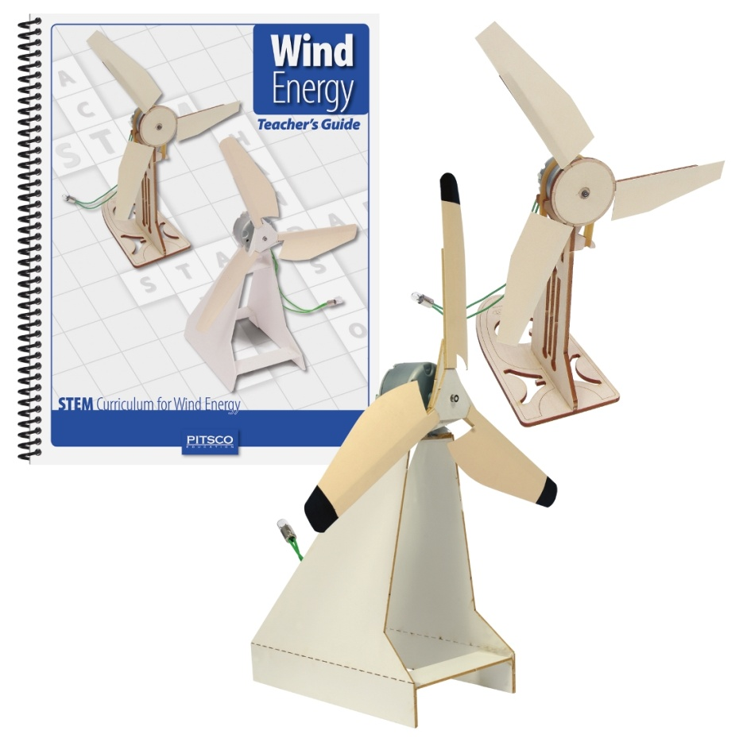
Wind Power
Description: Students will construct a device that converts wind into energy and answers questions on alternative energy.
Team: 2
Type: Hands-on/ Paper
Topics: Mechanics, Physics

Slide 25
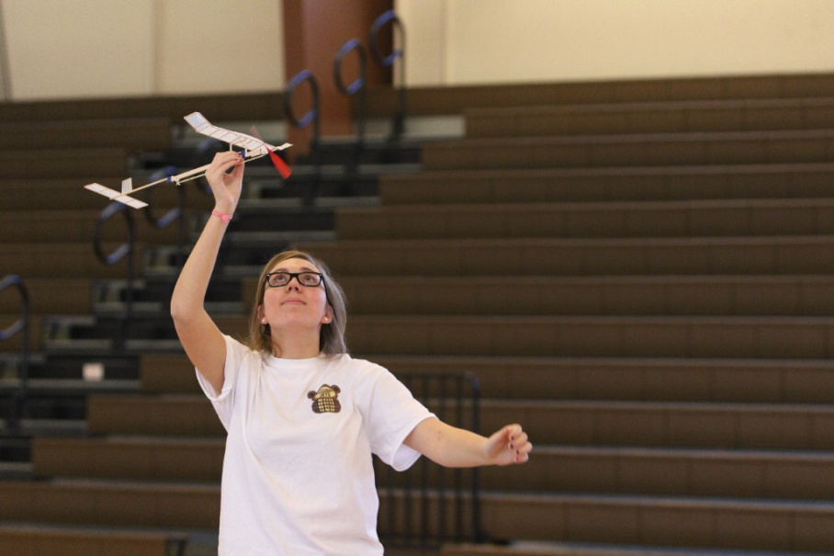
New: Wright Stuff
Description: Students will design, construct, and test a rubber powered monoplane to stay in the air for the longest time.
Team: 2
Type: Hands-on
Topics: Physics, Construction

Slide 26
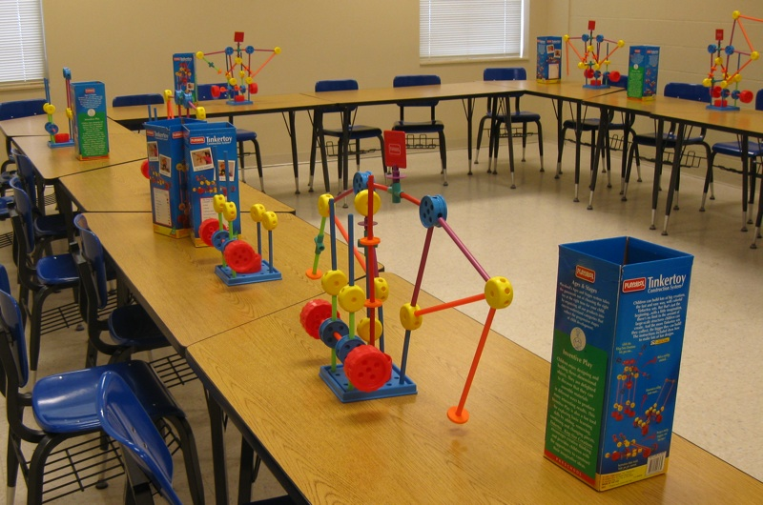
Write it, Do it
Description: One student describes an bunch of objects…their teammate has to rebuild it based on their description.
Team: 2
Type: Paper/ Hands-on
Topics: Medical Terminology and Writing

Slide 27
Important Dates
Regional Competition
Where: UW OSHKOSH
When: SATURDAY, FEB 11, 2017
How: Carpool
State Competition
Where: UW MILWAUKEE
When: SATURDAY, APRIL 7-8, 2017
How: Carpool

Slide 28
Parents and Family
Coaching
If you have a particular set of skills (and can spare a few hours a week) we would love to have you!
Materials
Many of the events require and use a wide variety of materials including:
Everything! ☺

Slide 29
Expectations
Students are expected to meet at least once a week.
We care about (in this order):
Having fun
Learning cool stuff
Winning

Slide 30
Thank You for Your Time!

